Slide 1
Smart Commerce
AI-Driven Smart E-Commerce Platform
E-Commerce
Inventory Intelligence
Analytics
Demand Forecasting
01

Slide 2
Real-Life Problem
Manual stock tracking
Scattered business data
Delayed restocking
Weak demand visibility
02

Slide 3
Project Overview
Full-stack commerce system
Admin, vendor, customer
Orders, inventory, analytics
Forecast-based decisions
03

Slide 4
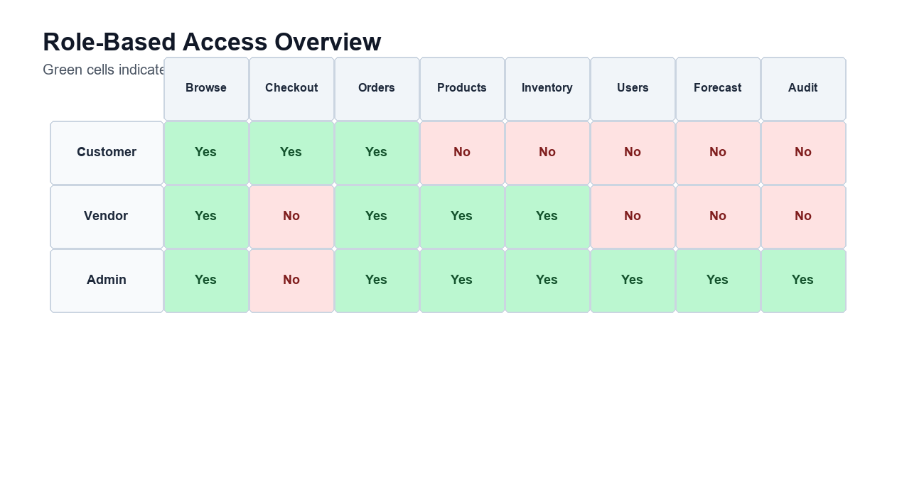
Key Features
Secure login
Role-based dashboards
Product and order management
Low-stock alerts
Forecast reports
04

Slide 5
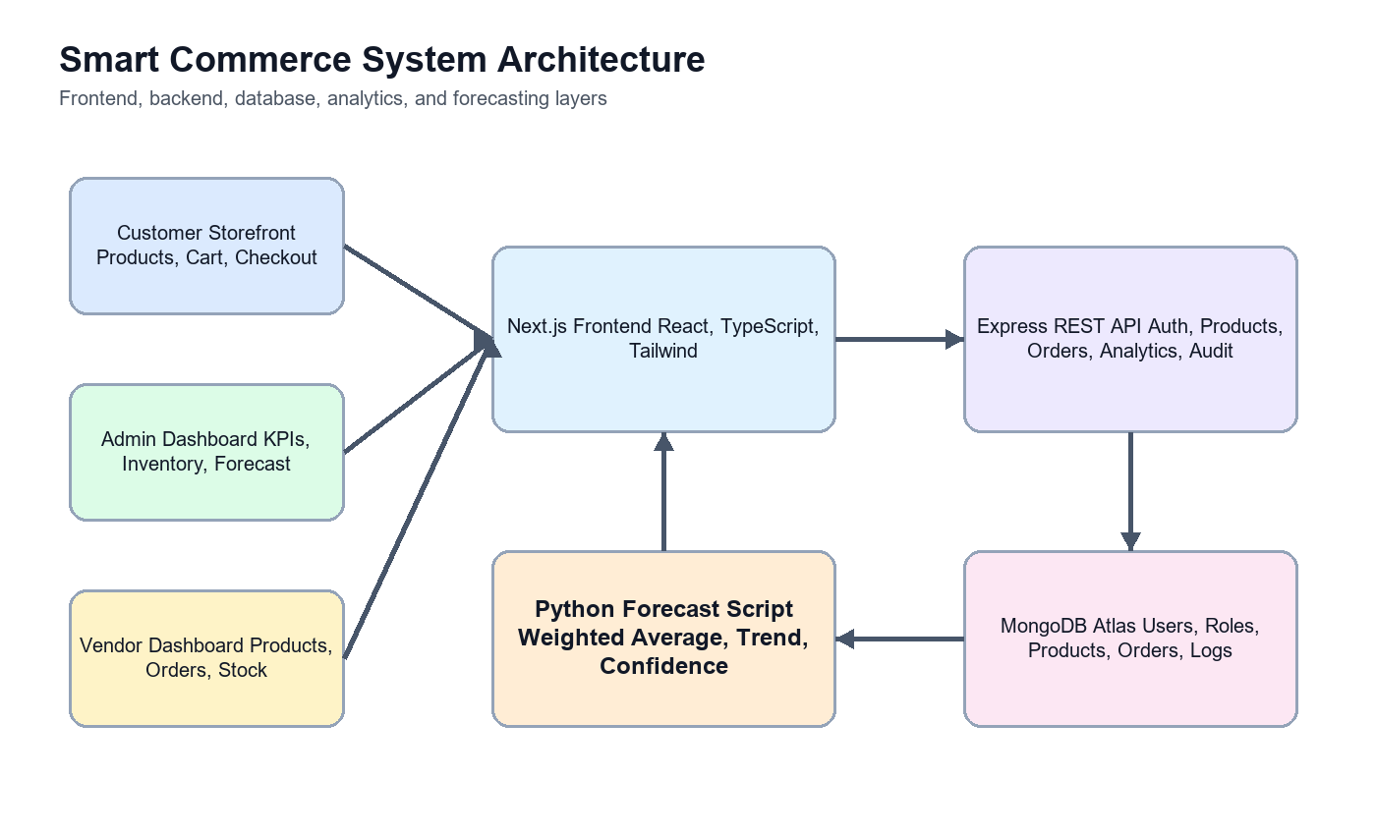
Architecture and Lifecycle
Client-server architecture
REST API
MongoDB persistence
DSR + Agile increments
05

Slide 6
Technology Used
Next.js, React, TypeScript
Node.js, Express.js
MongoDB, Mongoose
JWT, Docker, Python
06

Slide 7
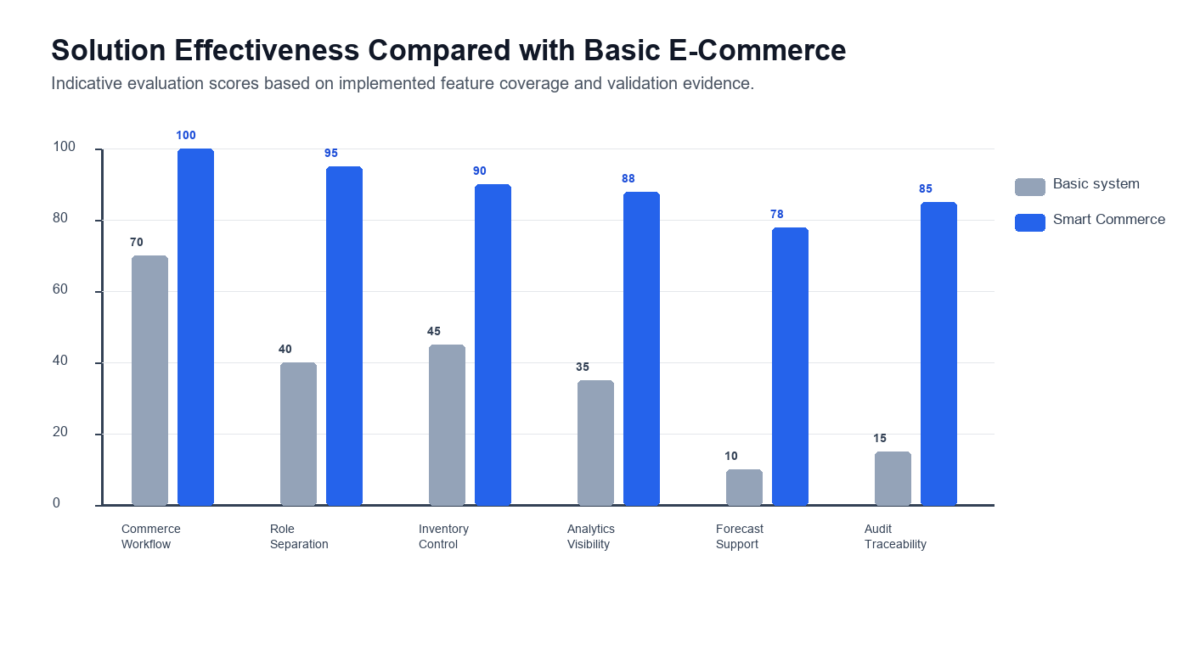
Business Value
Better visibility
Faster decisions
Reduced stock risk
Improved customer trust
07

Slide 8
Future Scope
Payment gateway
Recommendation engine
Advanced ML forecasting
Intelligent chatbot
Cloud deployment
08

Slide 9
Conclusion
Integrated platform
Operational intelligence
Graduate-level engineering
Scalable future roadmap
09

